Slide 1
Preventing Academic Dishonesty in High-Tech Environments
Strategies for Surgical Technology Educators

Slide 2
Objectives
Understand
- Understand the challenges of academic dishonesty in high-tech environments.
Identify
- Identify strategies to prevent cheating in both classroom and clinical settings.
Explore
- Explore tools and techniques to uphold academic integrity.

Slide 3

Understanding Academic Dishonesty
- **Definition**: Any form of cheating, plagiarism, or misrepresentation in academic work.
- Common forms in high-tech environments:
- Sharing test answers via smartphones.
- Unauthorized use of smartwatches or devices.
- Copy-pasting from online sources.
- Misuse of simulation tools or clinical assessments.

Slide 4
Challenges in Surgical Technology Education
- High reliance on technology for learning and assessments.
- Accessibility of information and tools online.
- Pressure on students to perform well in a demanding field.
- Difficulty monitoring students in clinical and virtual environments.

Slide 5
Common Cheat Sites and Apps
Chegg
How it’s used:
  Students use Chegg Study to upload questions from exams or assignments and receive step-by-step solutions, often in real-time during assessments.
Mitigation Tip:
  Incorporate open-ended or application-based questions that cannot be directly answered by Chegg’s resources.
Quizlet
How it’s used:
  Students search for answers to exams, quizzes, or assignments that others have uploaded. Quizlet also allows users to create and share flashcards, which can contain exact answers.
Mitigation Tip:
  Regularly check Quizlet for content related to your course and request removal of unauthorized materials.
Course Hero
How it’s used:
  This platform allows students to upload and access a wide range of course materials, including past exams, assignments, and study guides. Many students use it to search for answers or "study" exam questions.
Mitigation Tip:
  Require students to submit work in their own words and create unique assignments each semester.
Photomath
How it’s used:
  Students use this app to solve math problems by taking a picture of the problem. It provides step-by-step solutions for equations and word problems.
Mitigation Tip:
  Require students to show all their work and reasoning for math-based assessments.
Socratic by Google
How it’s used:
  Students use Socratic to take pictures of questions, and the app searches the web for relevant answers or explanations.
Mitigation Tip:
  Design assessments that involve critical thinking or unique scenarios not easily searchable online.

Slide 6
Common Cheat Sites and Apps
Reddit
How it’s used:
  Students post questions from assignments or exams and receive answers from Reddit users, often very quickly.
Mitigation Tip:
  Include questions that are personalized or scenario-based to make them harder to share or answer in generic forums.
Brainly
How it’s used:
  Similar to Chegg and Course Hero, Brainly allows students to post questions and receive community-sourced answers. The platform also provides pre-answered questions in its database.
Mitigation Tip:
  Monitor Brainly for course-specific content and design open-book assessments that emphasize reasoning over recall.
AI Writing Tools (e.g., ChatGPT, Jasper AI)
How it’s used:
  Students use AI to generate essays, short answers, or even creative responses to assignments, bypassing the effort of writing themselves.
Mitigation Tip:
  Use plagiarism detection software that detects AI-generated content (e.g., Turnitin's AI detection features) and design assignments that require personal reflections or references to in-class discussions.
Study.com
How it’s used:
  Provides detailed answers to questions in a variety of subjects, often mirroring the content of college-level courses.
Mitigation Tip:
  Create assessments based on in-class discussions, personal reflections, or unique scenarios.
Discord/WhatsApp/Group Chats
How it’s used:
  Students create private group chats to share answers, discuss exams, or collaborate during assessments.
Mitigation Tip:
  Use proctoring software for online exams and address the importance of academic integrity in group settings.

Slide 7
Impact of Academic Dishonesty
- **For Students**: Poor skill development, compromised patient safety.
- **For Educators**: Reduced credibility of assessment results.
- **For the Profession**: Erosion of trust and ethical standards.

Slide 8
Prevention Strategies
- **Clear Policies**:
- Establish and communicate academic integrity policies.
- Include specific guidelines on the use of technology.
- **Proactive Education**:
- Discuss the importance of honesty in surgical technology and patient safety.
- Conduct workshops on ethical practices in academics and clinical settings.

Slide 9
Technology-Based Solutions
- Use of anti-cheating software for online tests.
- Monitoring tools like Respondus or ExamSoft.
- AI-based plagiarism detection tools for written work.
- Restricted device use during exams or clinical assessments.

Slide 10
Designing Cheating-Resistant Assessments
- Create application-based and scenario-driven questions.
1
- Use randomized question pools in assessments.
3
- Incorporate oral or practical evaluations.
4
- Focus on competency-based rather than memory-based evaluations.
5
Group-Based Assessments with Accountability
6
Sequential Assessments
7
Open-Ended Reflection Questions
2
Video-Based Role Play/ Proctored Simulated Exams
8
Dynamic “What Would You Do Next?” Questions

Slide 11
Scenario Driven Questions
Sterile Technique Application
Scenario:
You are the surgical technologist in a total knee replacement procedure. During the surgery, the surgeon accidentally brushes their gloved hand against a non-sterile surface.
Question:
What steps should you take immediately to maintain sterility in the operating room?
How would you communicate this to the surgical team?
Answer Key:
Inform the surgeon immediately about the contamination.
Provide the surgeon with a replacement sterile glove or request that they reglove entirely with assistance from the circulating nurse.
Ensure the contaminated item (if any) is removed from the sterile field.

Slide 12

Open-Ended Reflection Questions
Example:
"Describe a situation where maintaining sterile technique might be challenging and explain how you would overcome it."
Why It’s Resistant:
Personalized responses require critical thinking and individual reflection, making answers difficult to duplicate.

Slide 13
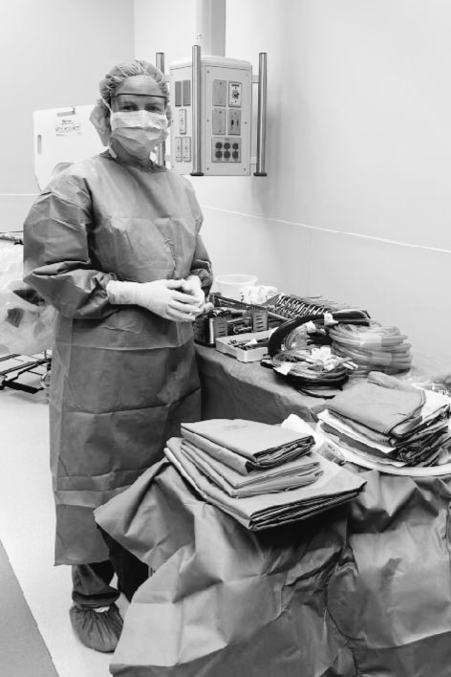
Group-Based Assessments with Accountability
Example:
Assign small groups to prepare and present on topics like surgical pathology or patient safety, with peer evaluations factored into grades.
Why It’s Resistant:
Collaboration ensures multiple inputs, and peer evaluations hold individuals accountable for their contributions.

Slide 14
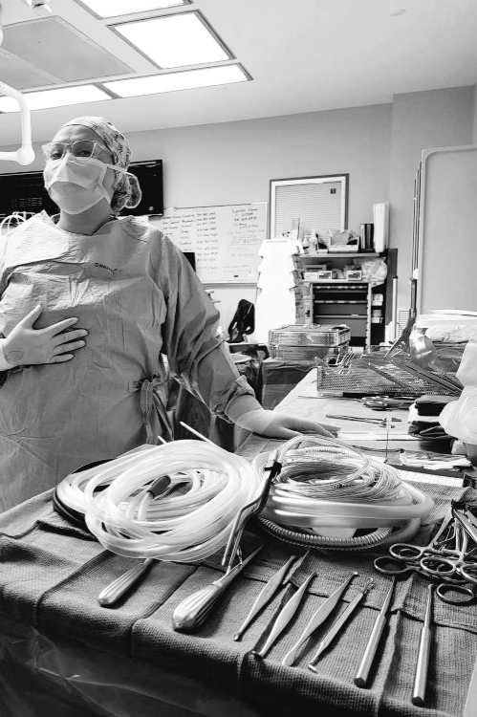
Sequential Assessments
Example:
Break assessments into stages, such as diagnosing a sterile field breach, followed by proposing solutions, and finally reflecting on the situation.
Why It’s Resistant:
Multi-part assessments ensure students must understand the process and not just the final answer.

Slide 15
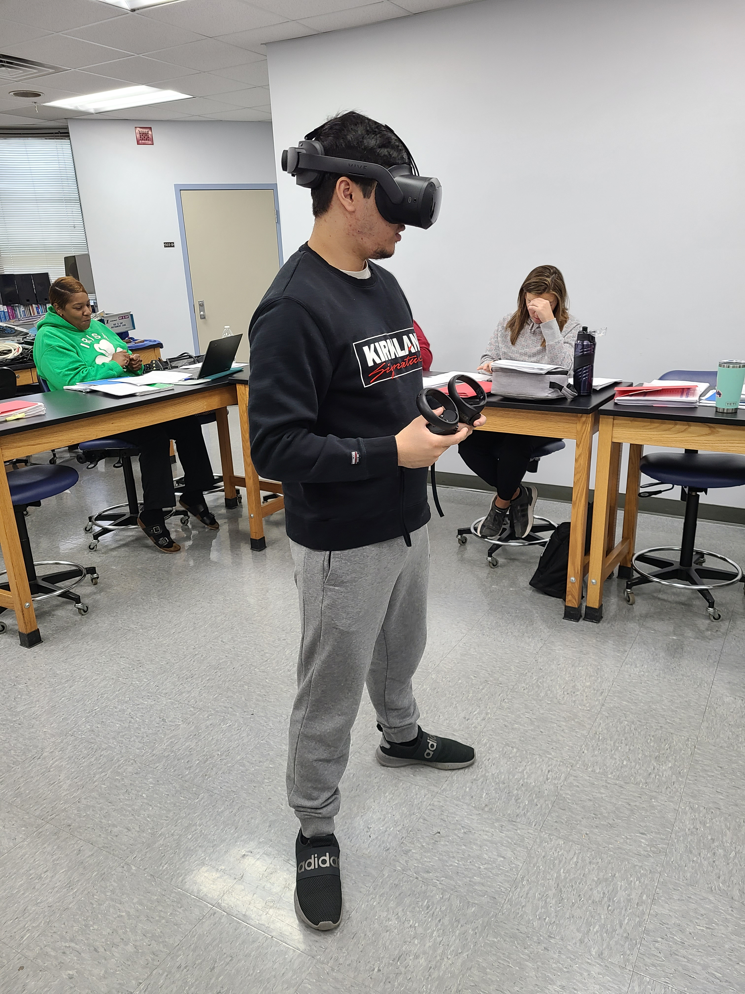
Video-Based Role Play/Proctored Simulated Exams
Example:
Ask students to record themselves responding to prompts, such as demonstrating how to respond to a contaminated glove or explaining how to set up for a laparoscopic procedure.
Why It’s Resistant:
Video assessments capture real-time problem-solving and physical actions, making it difficult to fake or cheat.
Example:
Use simulated OR environments or virtual reality (VR) tools to evaluate skills like instrument passing, positioning, and communication.
Why It’s Resistant:
Simulations test real-time decision-making, reduce reliance on outside resources or unauthorized assistance.

Slide 16

Dynamic "What Would You Do Next?" Questions
Example:
Use branching questions where each answer leads to a new scenario. For example, "The surgeon requests a clamp that is unavailable. What do you do next?"
Why It’s Resistant:
Students must adapt their answers based on initial choices, reducing the likelihood of sharing answers.

Slide 17
Fostering a Culture of Integrity
- Lead by example: Model ethical behavior.
1
- Build trust and rapport with students.
2
- Recognize and reward honesty and professionalism.
3

Slide 18
Monitoring in High-Tech Environments
- Encourage transparent environments during exams:
- Proctoring (in-person and online).
- Use of mirrored screens or surveillance tools.
- Limit unauthorized access:
- Block internet or device use during specific tasks.

Slide 19
Addressing Violations
- **Immediate Response**:
- Investigate and document incidents thoroughly.
- **Educational Approach**:
- Provide counseling and remediation opportunities for students.
- **Accountability**:
- Implement fair and consistent consequences for dishonesty.

Slide 20
Case Studies and Scenarios
- Present real-world scenarios of academic dishonesty in surgical technology.
- Discuss potential responses and preventative measures with the audience.

Slide 21
Case Study 1
Student is taking an online exam via recorded proctored exam.
The following infractions occur:
Student has TV playing in background.
Student moves from one room to another.
Student moves from a standing position to a sitting position.
Student speaks to another person in the room.

Slide 22
Case Study 2
Student is taking an online proctored exam
The following infractions occur:
Student has the TV playing in the background
Student is never in frame on the computer
Student turns off notifications to stay in frame
Student moves away from camera multiple times

Slide 23
Case Study 3
Student turns in a group discussion post
The following infractions occur:
The discussion post were turned in for groups of two students, the student that turned in the assignment under their name copied all work from their partner.
Under successive replies to other students this student claimed responsibility for the work.
This student’s partner had proof that they had done the work and shared the work with the other student to add content.

Slide 24
Conclusion
- Preventing academic dishonesty is a shared responsibility.
1
- Integrating policies, technology, and ethical education ensures integrity.
2
- Let’s commit to fostering a culture of honesty and professionalism.
3

Slide 25

Questions and Discussion

